Slide 1

Hotel Booking Analysis and Prediction
Machine Learning Project Rohit Rai
Notes:
NOTE:
To change the image on this slide, select the picture and delete it. Then click the Pictures icon in the placeholder to insert your own image.

Slide 2
Contents
Introduction
2. Data Collection
2.1. Importing Libraries
2.2. Gathering Data
2.3. Data Preprocessing
3. Exploratory Data Analysis (EDA)
3.1. Guests' Countries of Origin
3.2. Room Pricing Patterns
3.3. Busiest Months for Bookings
3.4. Average Daily Rate Analysis
3.5. Weekday and Weekend Booking Trends

Slide 3
Contents
4. Feature Engineering
5. Machine Learning Model Building
5.1. Logistic Regression
5.2. Naive Bayes
5.3. K-Nearest Neighbors
5.4. Random Forest
5.5. Decision Tree
6. Model Evaluation and Comparison
7. Conclusion

Slide 4
Introduction
The hotel booking industry is characterized by dynamic and complex patterns influenced by various factors such as seasonality, pricing strategies, and customer preferences. This project aims to analyze hotel booking data to gain insights into guest behaviors and trends, and to build predictive models to improve hotel management strategies, such as predicting cancellations. By leveraging data science techniques, we aim to provide actionable insights that can enhance operational efficiency and customer satisfaction.

Slide 5
Data Collection
2.1 Importing Libraries
Importing essential libraries like pandas for data manipulation, numpy for numerical operations, matplotlib and seaborn for data visualization, and scikit-learn for machine learning is crucial in data analysis. These libraries collectively enable tasks such as data cleaning, transformation, statistical analysis, and creating insightful visualizations.
2.2 Gathering Data
The dataset used in this project consists of hotel booking data from various sources. The data includes information on booking details, guest demographics, and hotel characteristics.
2.3 Data Preprocessing
Data preprocessing involves handling missing values, removing irrelevant columns, and filtering out anomalous entries. This step ensures that the dataset is clean and ready for analysis.

Slide 6
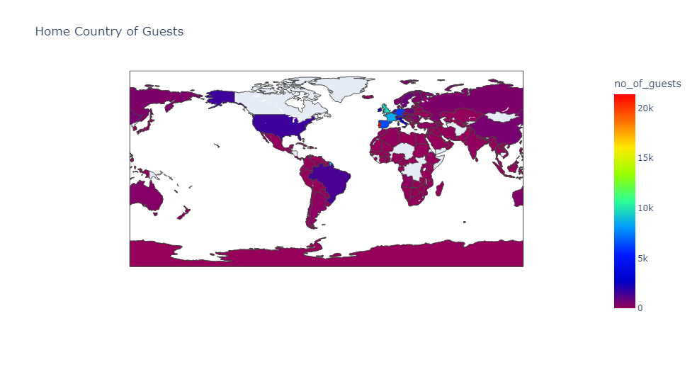
Exploratory Data Analysis (EDA)
3.1 Guests' Countries of Origin
Analyzing the distribution of guests' countries of origin helps in understanding the geographical diversity of the customer base. Visualizations such as bar charts and world maps can be used to represent this data.

Slide 7
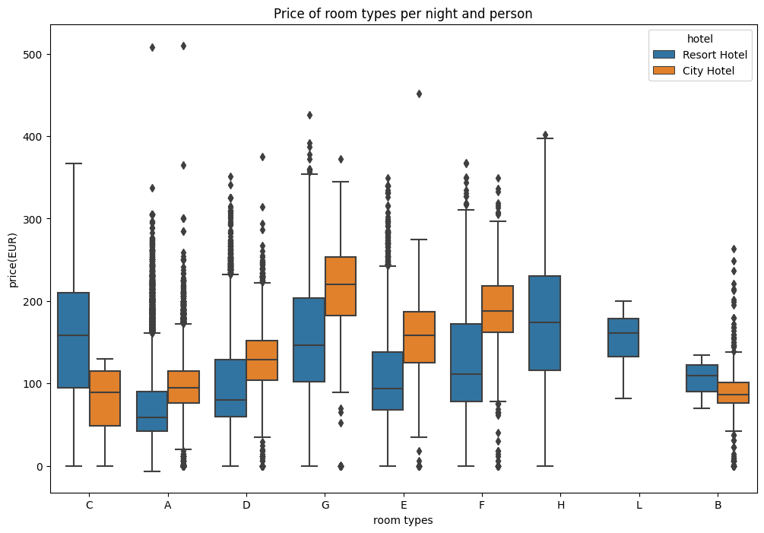
Exploratory Data Analysis (EDA)
3.2 Room Pricing Patterns
Understanding room pricing patterns is crucial for revenue management. This section involves analyzing how much guests pay per night and identifying factors influencing pricing.

Slide 8
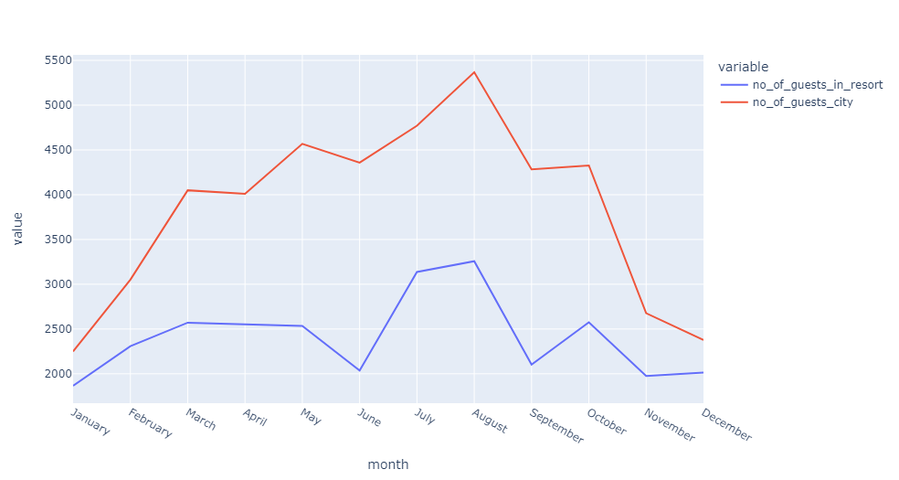
Exploratory Data Analysis (EDA)
3.3 Busiest Months for Bookings
Identifying the busiest months for hotel bookings helps in resource planning and management. Seasonal trends and peak periods are analyzed using line charts and bar graphs.

Slide 9
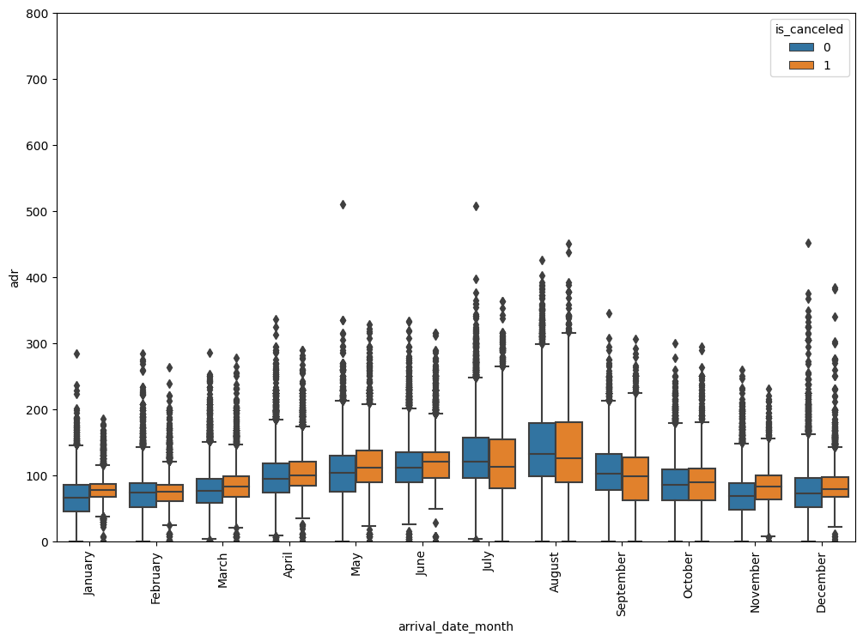
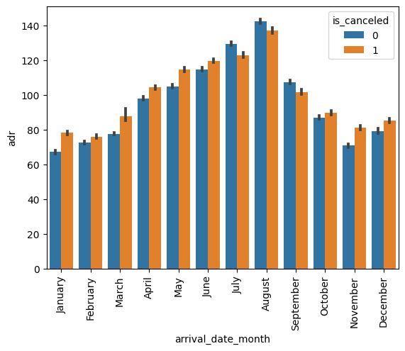
Exploratory Data Analysis (EDA)
3.4 Average Daily Rate Analysis
The average daily rate (ADR) is a key metric in the hotel industry. This section explores the ADR trends over different months to identify periods of high and low rates.

Slide 10
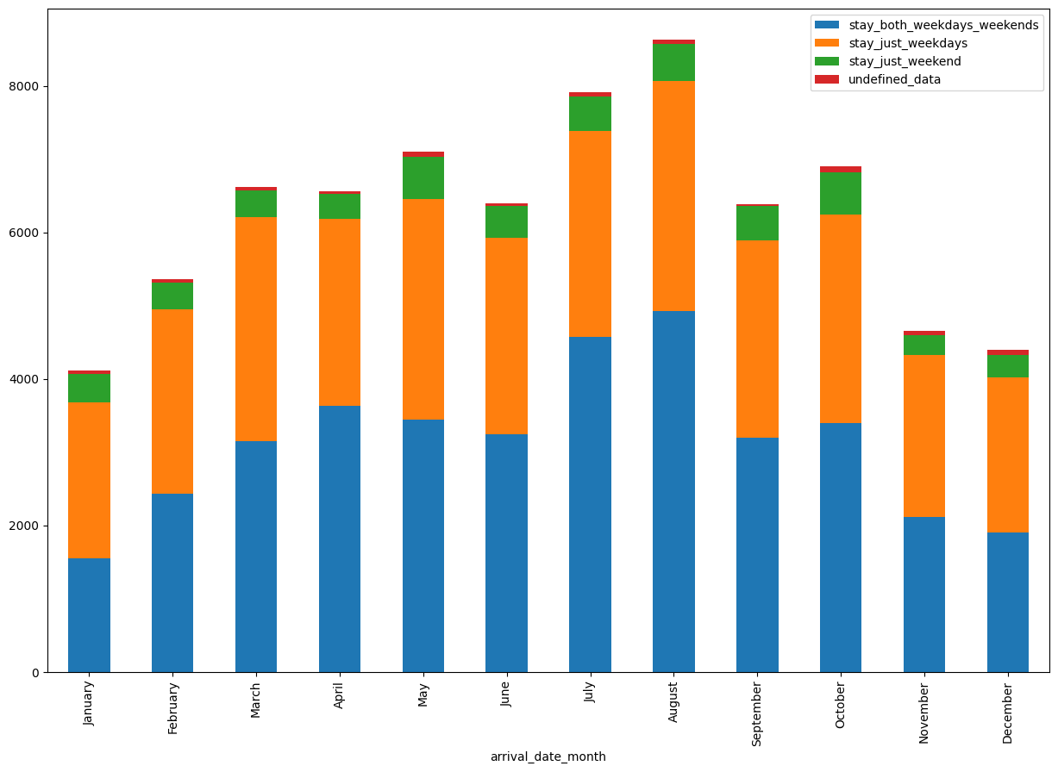
Exploratory Data Analysis (EDA)
3.5 Weekday and Weekend Booking Trends
Analyzing booking patterns concerning weekdays and weekends provides insights into customer preferences and helps in optimizing pricing and marketing strategies.

Slide 11
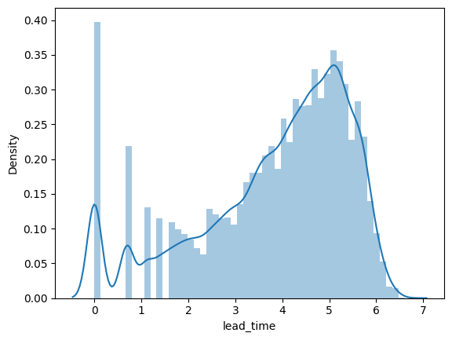
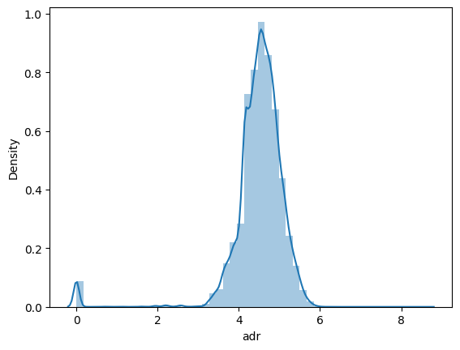
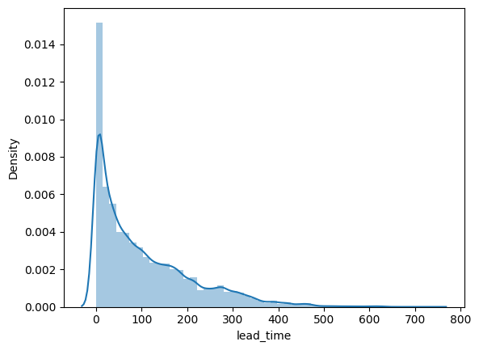
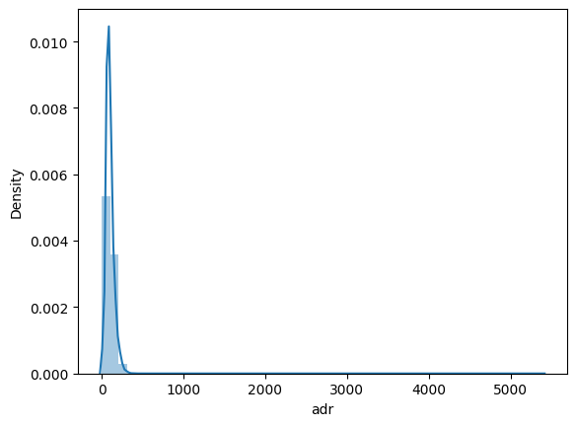
Feature Engineering
Feature engineering involves creating new features from the existing data that can improve the performance of machine learning models. This includes encoding categorical data, handling outliers, and selecting important features based on correlation analysis.

Slide 12
Machine Learning Model Building
5.1 Logistic Regression
Logistic regression is used for binary classification problems. In this project, it is applied to predict whether a booking will be canceled.
5.2 Naive Bayes
Naive Bayes is a probabilistic classifier that is useful for its simplicity and efficiency. It is employed to predict booking cancellations based on various features.
5.3 K-Nearest Neighbors
K-Nearest Neighbors (KNN) is a non-parametric method used for classification. It is applied to predict cancellations by finding the most similar bookings in the dataset.
5.4 Random Forest
Random Forest is an ensemble learning method that provides high accuracy by combining multiple decision trees. It is used for predicting cancellations with a focus on feature importance.
5.5 Decision Tree
Decision Trees are used for classification by creating a model that predicts the value of a target variable based on several input features. It provides a visual representation of decision-making.

Slide 13
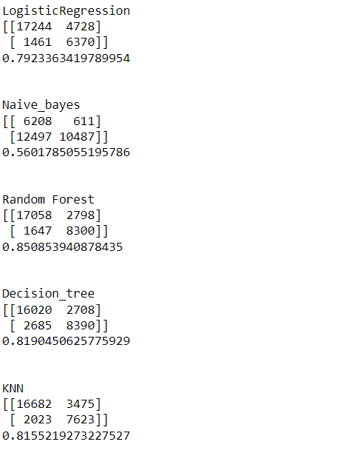
Model Evaluation and Comparison
The models are evaluated based on metrics such as accuracy, precision, recall, and F1-score. Cross-validation is performed to ensure the robustness of the models. A comparison is made to identify the best-performing model for predicting booking cancellations.

Slide 14
Conclusion
In conclusion, the hotel booking analysis and prediction project demonstrate the application of data science techniques to understand guest behaviors and trends.
The insights gained from the EDA provide valuable information for strategic decision-making, while the predictive models offer a robust tool for managing cancellations.
By leveraging data-driven approaches, hotels can enhance operational efficiency, improve customer satisfaction, and optimize revenue management.

Slide 15
Thank you

